Slide 1
Re-Identification and growth detection of pulmonary nodules without image registration using a 3D Siamese Neural Network
Saifeddine BARKIA
Antoine CADIOU
Gonzalo REINOSO

Slide 2
SUMMARY
Introduction
Growth detection pipeline
1.1 Nodule detector
1.2 Nodule matching
Experiments and results of the pipeline
Conclusion and Discussion

Slide 3
Introduction

Slide 4
Growth detection pipeline
Notes:
So, in the paper They have divided their growth detection pipeline in 2 different tasks.

Slide 5
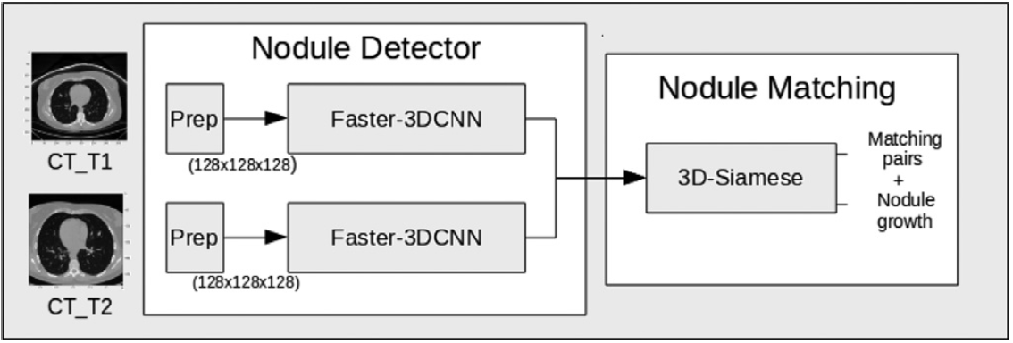
1.1 Nodule detector
2 CT-scans of the same patient, taken at two different times
Preprocess them (time complexity reasons)
Splitting the CTs in patches of size 128*128*128
Looking for Nodules in each of them.
Extract the detected nodules into 2 lists and sort them.
Figure 1. Source: Rafael-Palou et al (2021) [2].
Notes:
The first one consists of extracting nodules from 2 differents CT-scans from the same patient (but taken at different time).
It has been achieved using a Faster-RCNN in 3D (because CT scans are in 3D).
We had to preprocess our data:
We have splitted our CTs in small patches and we gave them as input to our detector model
It was mandatory because of a time complexity reason,
So once it is done, we are capable to extract the detected nodules and to put them in 2 lists (corresponding to each CT in input).

Slide 6
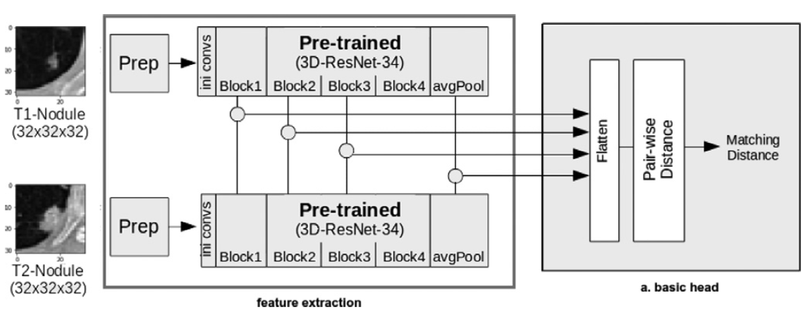
1. 2 Nodule Matching with Siamese NN
Inputs are the detected nodules from each list.
Output can be a matching distance score or a probability.
Figure 2. Source: Rafael-Palou et al (2021) [2].
Notes:
The aim of the siamese NN is, given a pair of nodule, to say How likely they are the same?
For the nodule with the highest probability in the first CTscan, we seek for the corresponding one in the ones in the second list.
The final objective will be to extract values such as the growth ratio or the matching distance
they have thought of 4 different heads, here is the basic one...
[seogt]

Slide 7
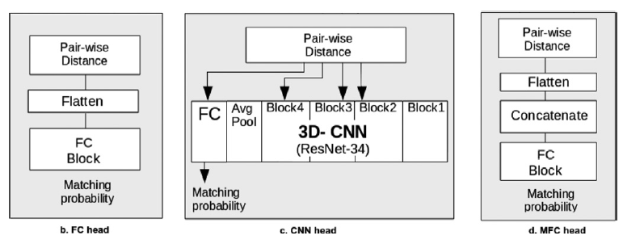
Implementation part
Used Resnet-34 as backbone
Implemented 2 heads out of 4
Tested on synthetic data
Figure 3. Source: Rafael-Palou et al (2021) [2].
Notes:
We have implemented it !
We find it more interesting to implement the nodule matching part since the nodule detector is already implemented in the PyTorch library (for the FasterRCNN).
So we implemented the Resnet-34 as the backbone for our model (to extract the features from the input images) and we also implemented 2 types of heads (out of 4).
We wanted to test our model on 3D real images of nodules however, we didn’t find any pre-trained Resnet-34 to test the matching.
For that reason, we tested our model on synthetic 3D tensors/voxels and it works fine.
__________
Contrastive Loss (because outputs are distances) and BCE Loss (for probabilities)

Slide 8
2) Experiments and results of the pipeline

Slide 9
2.1 Datasets used
Backbone of the SNN extracted from nodule classification network trained on LUNA-16 challenge dataset (888 CT scans comprising a total of 1186 nodules).
VH-lung dataset was used for performance evaluation. It comprises 151 pairs of CTs with only one nodule annotated by clinicians.

Slide 10
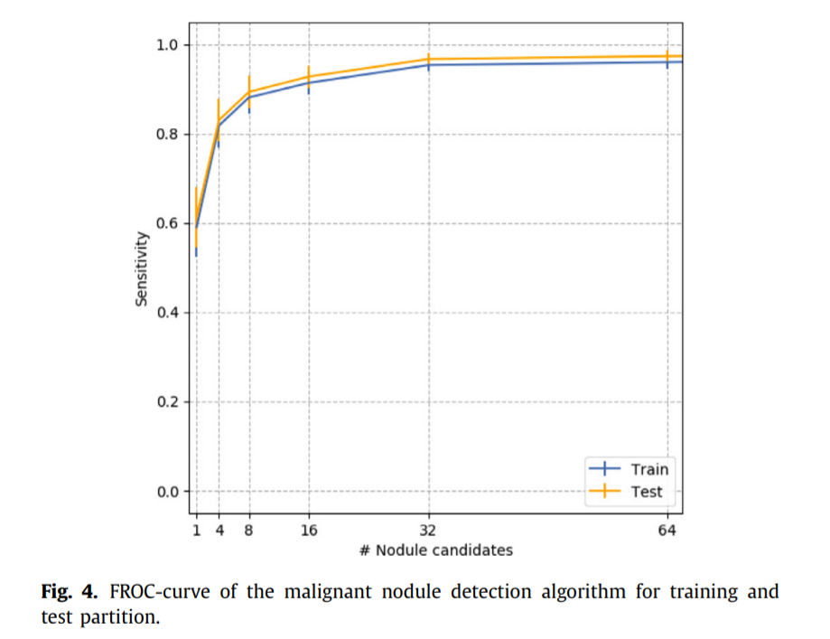
2.2 Evaluation of nodule detection performance
The ability of the nodule detector to detect the nodules annotated by cardiologists (one per CT) on the VH-Lung dataset was computed.
Different number of nodule candidates were proposed.
Computed per CT whether the annotated nodule was in each subset of predicted nodule candidates (ranked by probability).
32 candidates per CT were chosen (good trade-off between precision and sensitivity). In testing, a sensitivity of 0.973 is reached.
Figure 4. Source: Rafael-Palou et al (2021) [2].

Slide 11
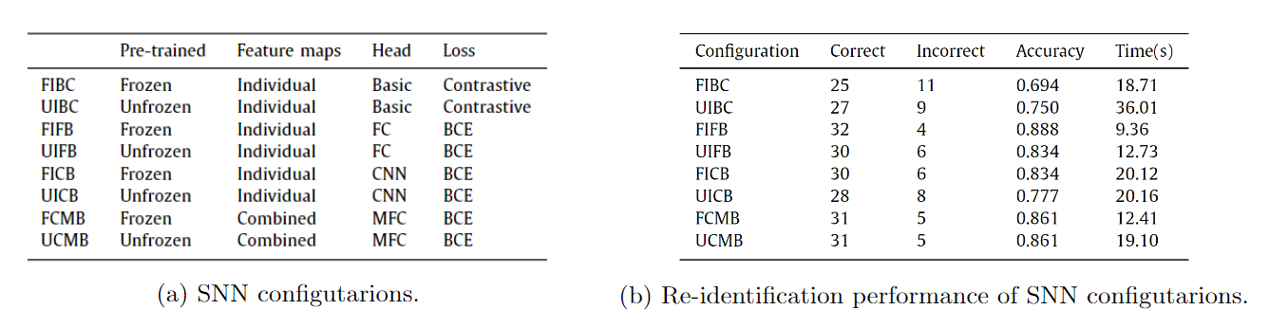
2.3 Evaluation of nodule re-identification performance
Each annotated nodule at the CT at T1 was paired with each candidate at CT at T2 and then the crops around them were fed to the SNN.
The network provided a matching probability for each pair of candidates.
It was computed for each pair of CTs, whether the candidate at T2 predicted with highest probability by the SNN, matched with the annotated nodule at T2.
FIFB offers the best results with an accuracy of 88.8% (32/36).
Table 1. Source: Rafael-Palou et al (2021) [2].

Slide 12
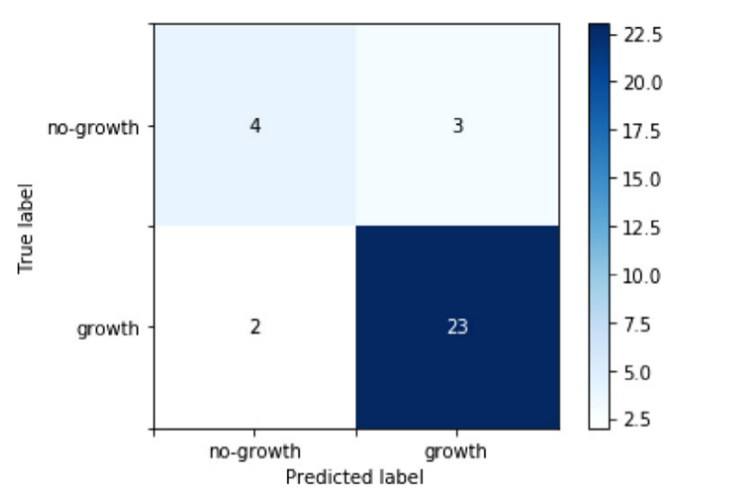
2.4 Evaluation of nodule growth calculation
The best pipeline (FIFB) was evaluated for nodule growth detection.
Correct prediction = difference on diameters between predicted and ground truth nodules had same sign. It was obtained a 92% of recall and a 88% of precision.
Figure 5: Confusion matrix. Source: Rafael-Palou et al (2021) [2].

Slide 13
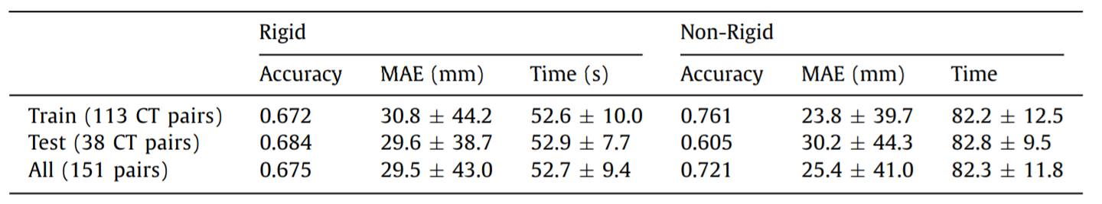
2.5 Automatic lung CT registration
Rigid and non-rigid registration.
Correct cases: Euclidean distances between the centroids at T2 and the warped locations of the centroids at T1 < nodule’s radius squared.
Worse results than re-identification with SNN.
Table 2. Source: Rafael-Palou et al (2021) [2].

Slide 14
Conclusion & Discussion

Slide 15
Conclusion

Slide 16
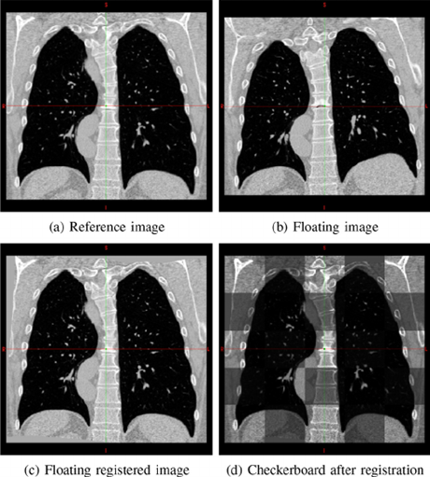
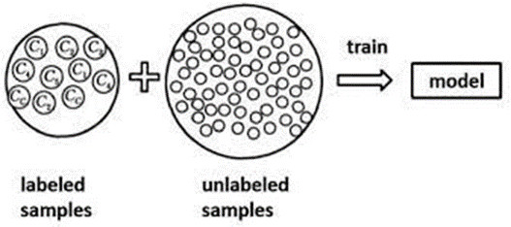
Semi-supervised techniques with registration
Improvement: image annotations
Combining a small amount of labeled data with a large amount of unlabeled data.
Not all the prediction would be accurate.
Do image registration.
Keep only detections where the registration of the new two images corresponds
Figure 7: Source:
Mathieu Rubeaux et al
(2019) [4].
Figure 6: Source: Hong Liu et al (2019) [3].

Slide 17
Self supervised annotation techniques
•Having a lot of success especially with the DINO algorithm by FAIR in natural images.
•We will not have very good results with medical images.
•Use the detected regions by the Self supervised algorithm as region proposal.
•Use radiologists to check those regions / run a classifier around those regions instead of running it of all the images to detect the abnormal nodules

Slide 18
Improvement: Nodule detection
Another use for image registration:
What they did in the paper:
Nodule detection for both CT per patient → Nodule matching based on the highest probability
What we propose:
Nodule detection for both CT per patient → Image registration → Nodule matching in the neighborhood of the registered image → Selecting the highest probability pair in the neighbourhood.

Slide 19
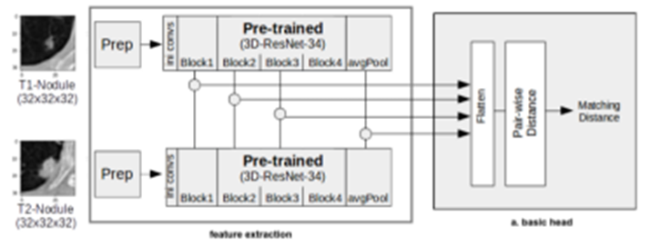
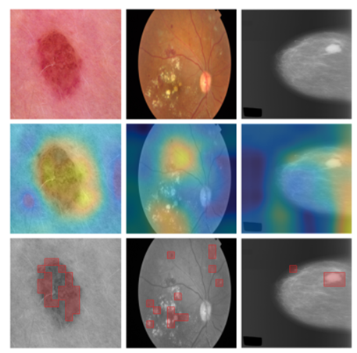
Improvement : Use Vision Transformers for SNN backbone
•Transformers emerged from NLP to vision and having good results.
•We propose to replace the Resnet34 used in SNN with transformers to extract features
Figure 8: Source:
Rafael-Palou et al (2021) [2].
•Based on [1], they applied to medical imaging, it is observed
that ViT outperformed CNNs using supervised and
unsupervised weights.
•Viewing transformer attention maps
Figure 9: Source: C. Matsoukas et al (2021) [1].

Slide 20
List of references
[1] C. Matsoukas, J. F. Haslum, M. S¨oderberg, and K. Smith, “Is it time to replace cnns with transformers for medical images?,” arXiv preprint arXiv:2108.09038, 2021
[2]Xavier Rafael-Palou, Anton Aubanell, Ilaria Bonavita, Mario Ceresa, Gemma Piella, Vicent Ribas, and Miguel A. Gonzalez Ballester. Re-Identification and growth detection ´ of pulmonary nodules without image registration using 3D siamese neural networks. Med. Image Anal., 67:101823, 2021
[3]Hong Liu, Chang Liu, Runwei Ding. “Semi-supervised long short-term memory for human action recognition” Available from: https://www.researchgate.net/figure/Pipeline-of-semi-supervised-learning_fig1_343257225 [2 Dec, 2021]
[4]Mathieu Rubeaux, Jean-Claude Nunes, Laurent Albera, Mireille Garreau. Medical image registration using Edgeworth-based approximation of Mutual Information. Innovation and Research in BioMedical engineering, Elsevier Masson, 2014, 35 (3), pp.139-148. ⟨hal-00914411v2⟩

Slide 21
Thank you for your attention

